Slide 1
The Big 5 Databases
Introduction to Databases

Slide 2
Most commonly used databases
The most commonly used database are:
Hierarchical databases
Network databases
Object-oriented databases
Relational databases
NoSQL databases

Slide 3
Hierarchical Databases
In a Hierarchical database, data is organised in a tree-like structure
It can be viewed as a parent-child type relationship.
Each parent record can have several child records, each child record can only have one parent record
Data is stored in the form of records which are the collection of fields.
The records are connected through links.
Each field can contain only one value.
When data needs to be retrieved, the whole tree is traversed starting from the root.
An advantage of this model is that data can be retrieved easily.
A disadvantage is their inflexible nature and rigid structure doesn’t support complex relationships between data (only supports 1 – many relationships)

Slide 4
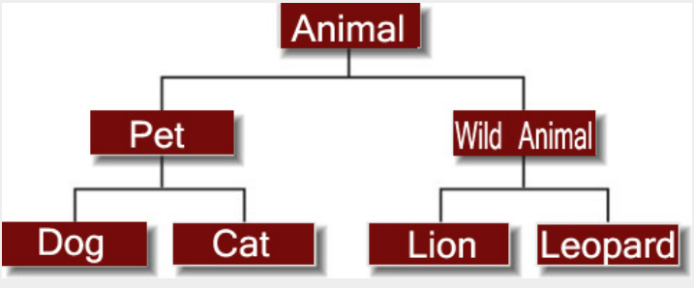
Hierarchical Database
Image - https://whatisdbms.com/

Slide 5
Network database
The network database model was created to solve the shortcomings of the hierarchical database model.
In this model a child can be linked to multiple parents.
The model can be viewed as an upside-down tree.
It allows each record to have multiple parent and multiple child records, which, when visualized, form a web-like structure of networked records.
An advantage of this model is can support many to many relationships.
A disadvantage of this mode is its complexity makes it difficult to manage and maintain.

Slide 6
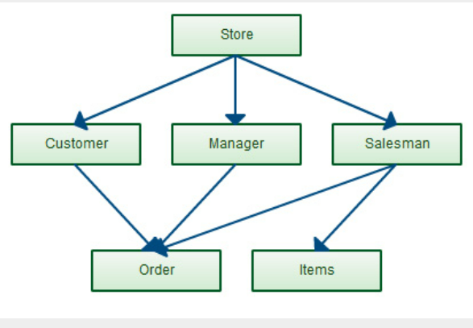
Network database
Image - https://whatisdbms.com/

Slide 7
Object Oriented Databases
Object-oriented databases emerged to meet the need of coupling object-oriented programming languages with a database
With an OOD, data objects are stored with all of their properties in the database.
All of the information is directly available instead of distributing everything across different tables
The OO Database model has been around since the late 1970s, however very few object oriented DBMSs have emerged.
It is advantageous to use an object oriented database when already working with object-oriented programming and it can easily manage complex data with complex object to object associations.
A disadvantage of this model is that in some situations, the high complexity can cause performance problems.

Slide 8
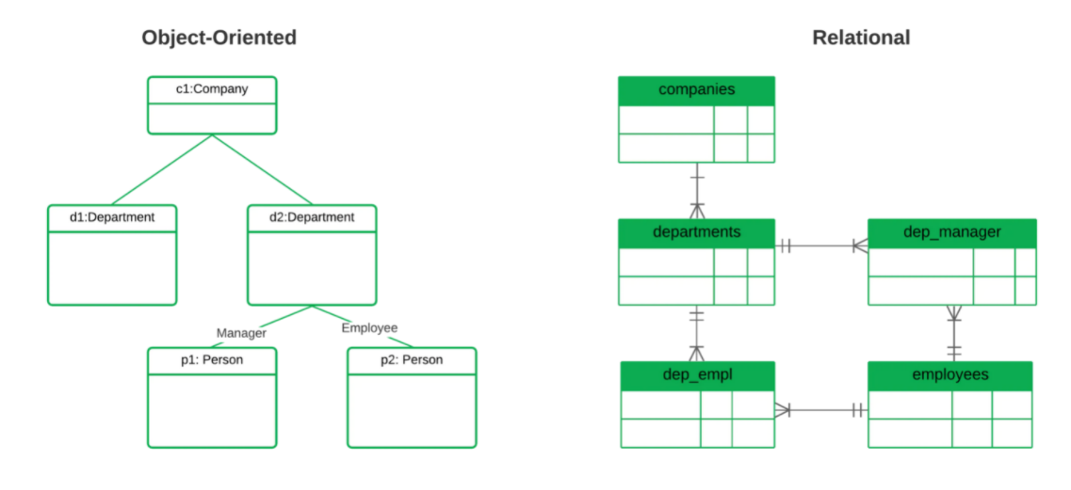
OBJECT OREIENTED database
Image - https://www.mongodb.com/databases

Slide 9
RELATIONAL DATABASE
Relational databases are based on the relational model, a way of representing data in tables.
Each row in the table is a record with a unique ID called the key.
The columns of the table hold attributes of the data
To ensure that data is always accurate and accessible, relational databases follow certain integrity rules e.g., duplicates are not allowed
An advantage of this database is its simplicity in terms of architecture, structure and design.
A disadvantage is s the database becomes larger its overall performance will be impacted negatively.

Slide 10
RELATIONAL database
Product Code | Description | Price
243 | Doughnuts | 3.50
132 | Cupcakes | 4.75
562 | Croissants | 4.25
Invoice Code | Product Code | Price

Slide 11
NoSQL Database
NoSQL databases, "not only SQL“, are non-tabular databases.
The term is typically sued to refer to any non-relational database.
NoSQL databases emerged in the late 2000s.
NoSQL databases allow developers to store huge amounts of unstructured data, providing a lot of flexibility.
NoSQL databases come in a variety of types including document databases, key-values databases, wide-column stores, and graph databases.
Advantages of this model include flexible data models, horizontal scaling, and fast performance.
One disadvantage is that there are no standardization rules.

Slide 12
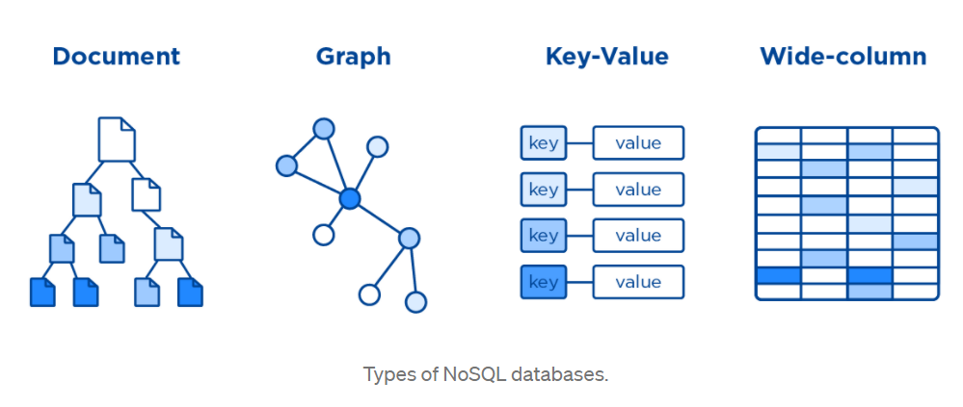
NoSQL Database
Image courtesy of https://medium.com/

